Slide 1
Foundations for an applied science of data visualization
Geospatial Visualization
Dr. Tateosian
Center for Geospatial Analytics
Reference: Ware, Colin. Information visualization: perception for design. Chapter 1. Elsevier, 2012.

Slide 2
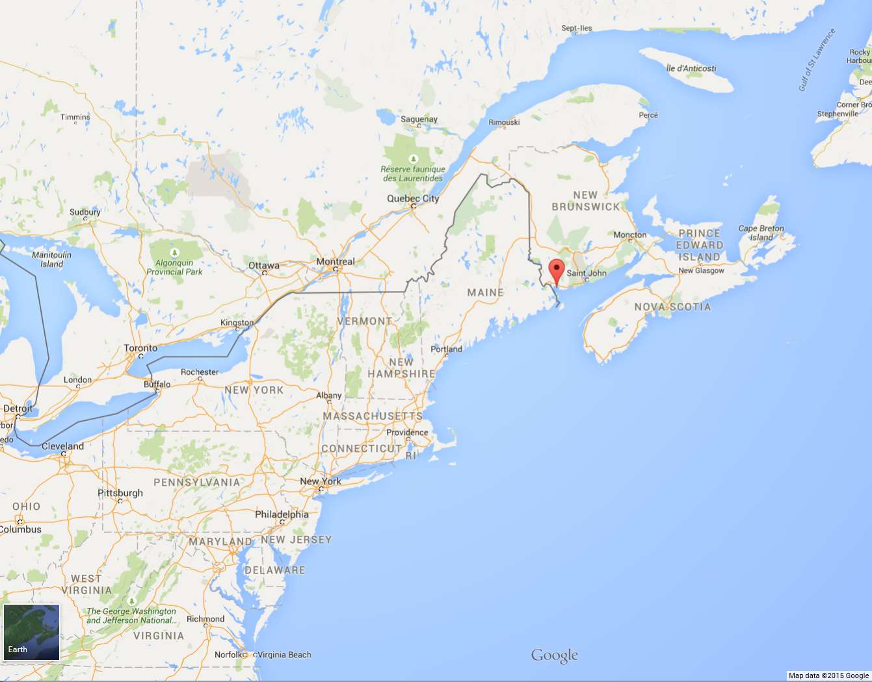
Advantages of visualization
Convey huge amount of data
Reveal surprising patterns (e.g., pockmarks aligning with geologic fault lines)
Problems with the data are immediately apparent (e.g., ripples that are artifacts of the ship tossing)
Both large and small scale features can be explored.
Facilitate hypothesis formation (E.g., pockmarks formation?)
Multibeam echo sounder scan of
Passamoquoddy Bay

Slide 3
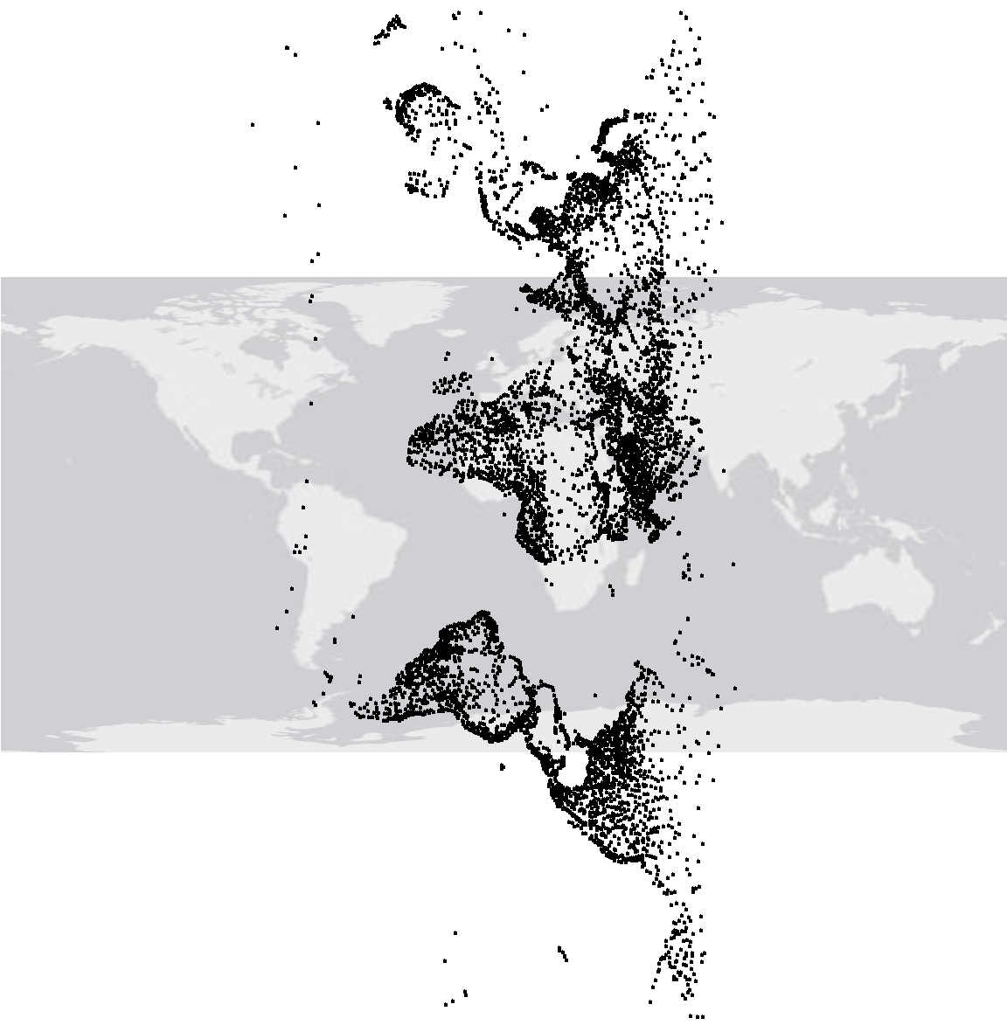
Have you done this?
What’s the problem?
Problems with the data are immediately apparent…
White=land masses, grey=water, black=eye fixations

Slide 4
Have you done this?
What’s the problem?
Problems with the data are immediately apparent…

Slide 5
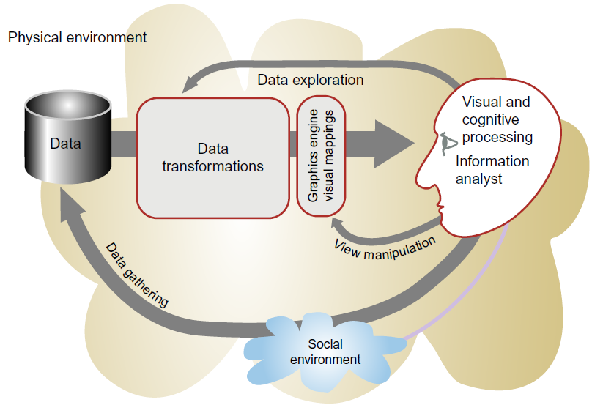
Visualization stages and some tools
Data collection and storage
GPS, shapefiles, rasters, mySQL, PostGres/PostGIS
Preprocessing
Python and R packages
Mapping from data to visual representation
Color brewer, map brewer, QGIS, Leaflet
Human perceptual and cognitive system
Human visual system

Slide 6
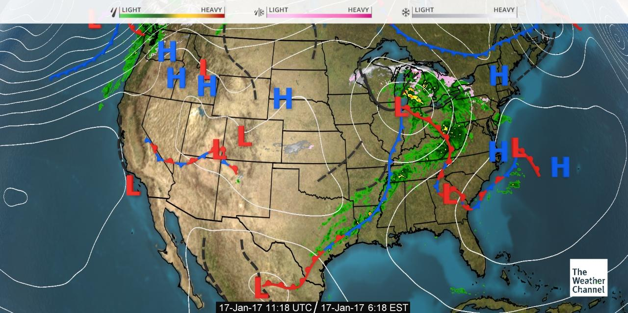
Mapping from data to visual representation

Slide 7
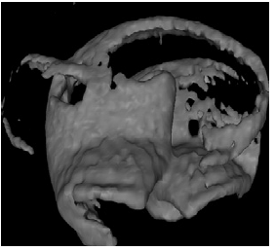
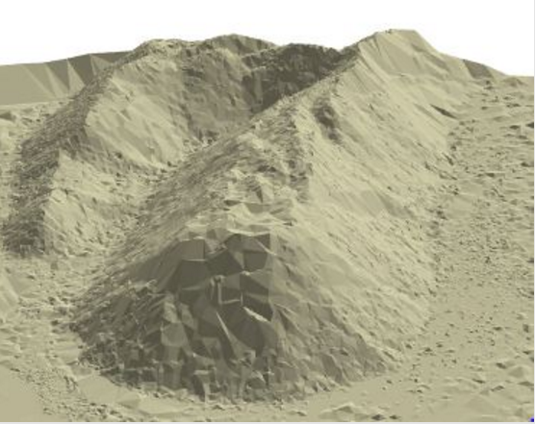


Sensory versus arbitrary symbols
Sensory: symbols and aspects of visualizations that are expressive because of their ability to use perceptual processing powers of the human brain (without learning).
Arbitrary: representations that must be learned. Employs symbols.
Left: “Expanding wavefront of a chemical reaction”
Right: Composite surface from UAV scan.
source: http://www.roninims.com/aims-taking-off/
We understand these as a 3d surfaces intuitively
Learned symbols

Slide 8
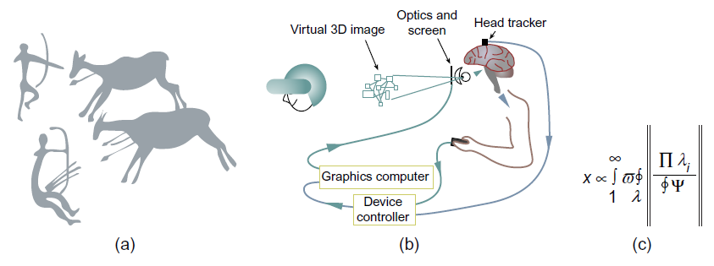
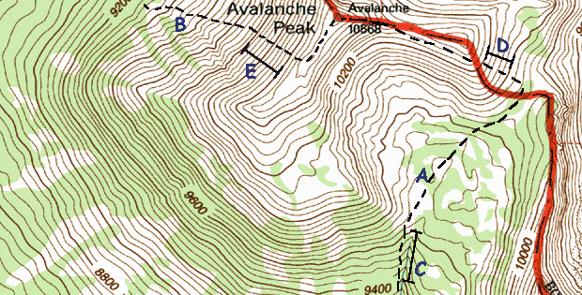
Semiotics
The study of symbols and how they convey meaning.
Bertin, Jacques. "Semiology of graphics: diagrams, networks, maps." (1983).
Are visual languages easy to learn and use? universal?

Slide 9
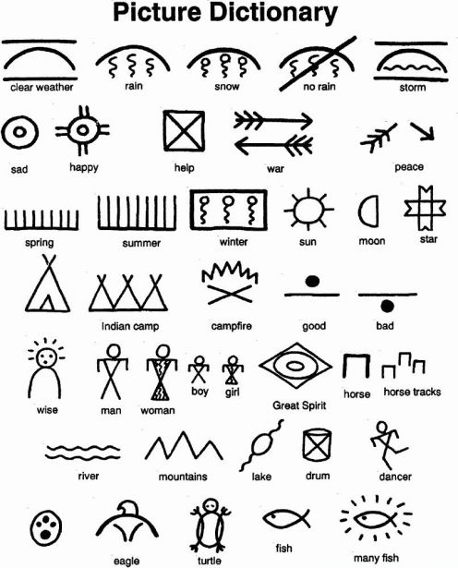
Semiology example
Source: https://leslieaross.wordpress.com/2010/10/27/adventures-in-native-american-symbols/
Native American symbols
Notes:
https://leslieaross.wordpress.com/2010/10/27/adventures-in-native-american-symbols/

Slide 10
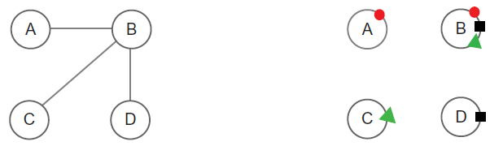
Perception of pictures
Are pictures as arbitrary as words?
Supporting example: Anthropologists showed a photo to a Bush woman seeing it for the 1st time. She turned the photo ‘this way and that, in attempting to make sense out of the shadings of gray on the piece of paper’ [1]
Is there some similarity between pictures and what they represent? Supporting example: We recognize people in line drawings.
Some symbols are better than others…
Example: These 2 approaches to
representing connectivity between
graph nodes.
[1] Herskovits, Melville Jean. Man and his works: The science of cultural anthropology. New York: AA Knopf, 1948.

Slide 11

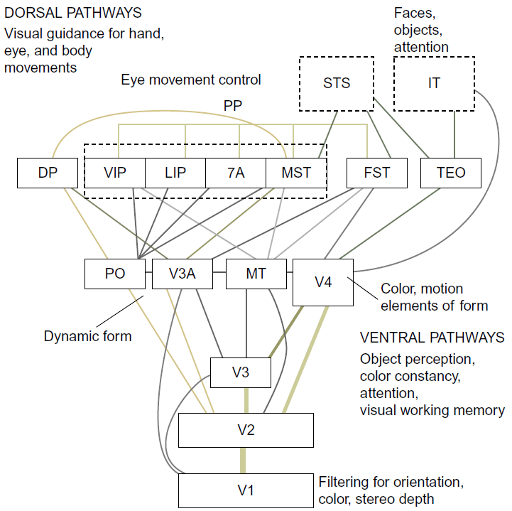
Sensory: Understanding without training
20 billion or so neurons of the human brain devoted to analyzing visual info. (~100 billion total neurons)

Slide 12
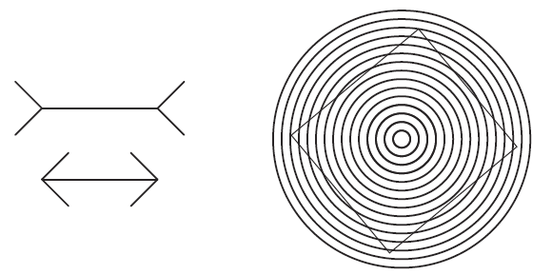
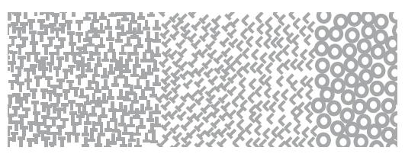
Properties of sensory representation
Enables understanding garnered without training
Is resistant to alternative connotations
Provides sensory immediacy
Illusions: We see one thing, though we know otherwise.
There are 5 regions with different patterns.

Slide 13
Sensory visualization guidelines
Use sensory representations when trying to increase understanding across cultural boundaries.
Design graphic representations of data by taking into account human sensory capabilities so that important data elements and data patterns can be quickly perceived.
Important data should be represented by graphical elements that are more visually distinct than those representing less important information. (we can base this in psychophysics).
Greater numerical quantities should be represented by graphical elements that are more distinct. (e.g., more strongly textured or vividly colored).

Slide 14


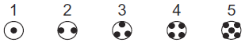
Arbitrary symbols
Hard to learn (e.g., reading and writing takes years)
Easy to forget, unlike sensory encodings.
Embedded in culture and applications.
Symbols can be transient.
Formally powerful.
Graphical symbols should be formalized within and across applications.

Slide 15

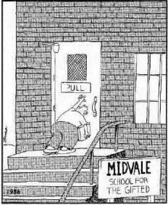
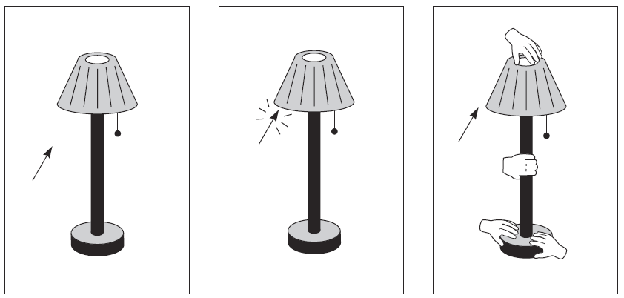
Affordance
Gibson: We perceive in order to operate on the environment. Perception is designed for action.
Affordances: perceivable possibilities.
We know if staircases are climbable;
knobs are pull-able

Slide 16
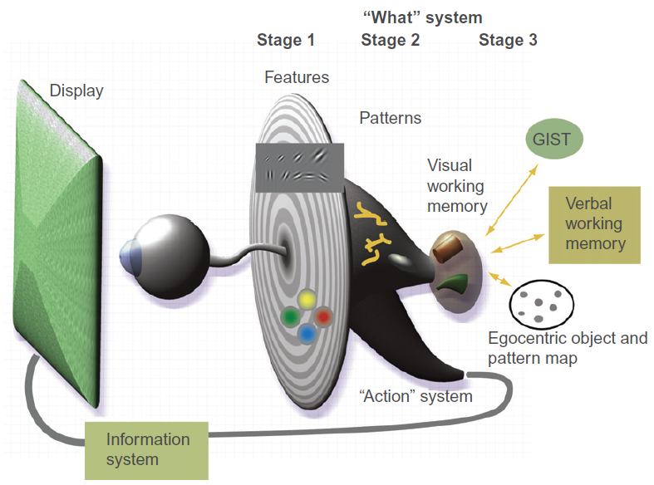
Model of perceptual processing
Stage 1: Parallel processing to extract low level properties
Rapid parallel processing (200ms)
Extract features (color, orientation, texture, movement)
Stage 2: Pattern perception
Slower serial processing (eye saccades)
Objects and patterns perceived
Stage 3: Visual working memory
Objects held in visual working memory by active attention
Only a few objects can be held at a time; constructed from available patterns.
Provide answers to a visual query. E.g., looking for a route on a road map, the visual query triggers a search for connected red contours (highways) between two symbols (cities)
The Ware book is organized by these stages

Slide 17
Summary
Advantages of visualization
Visualization pipeline
Sensory vs. symbolic
Affordance
Stages of perception

